Slide 1
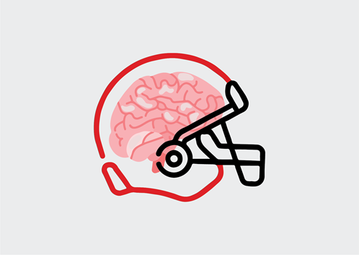
INDY-5 Helmet
Brian Bergmann & Patrick O’Connell

Slide 2
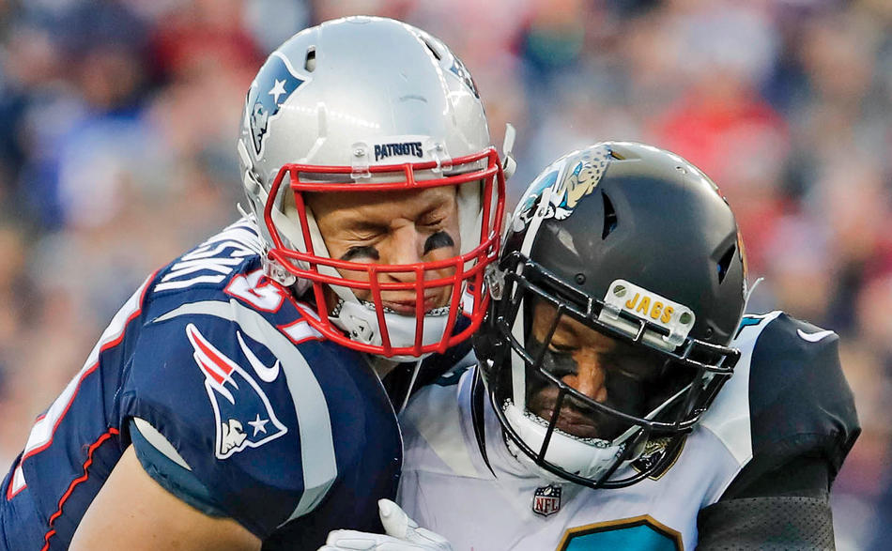
Concussions
A concussion can be defined as a temporary unconsciousness or confusion caused by blow to the head
According to the University of Michigan a concussion occurs at roughly 90-100 grams of force
219 concussions in the NFL in 2023 alone
If concussions are not treated, patients are at a greater risk of reinjury which can increase symptoms
Concussions can have long term effects such as CTE (Chronic traumatic encephalopathy)

Slide 3


Technology Used
Notes:
Raspberry PI - used to gather information given from accelerometer
Adafruit - accelerometer to track movement of the helmet, also provides a library for us to use

Slide 4
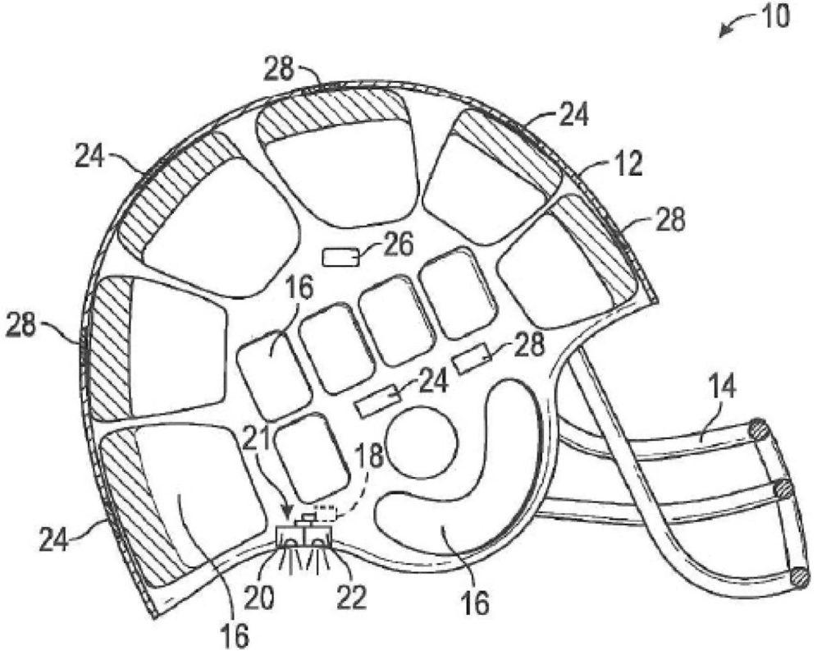
Our Helmet Design
Accelerometer
Creating a Helmet that can detect concussions without the user reporting
Placing a raspberry PI and accelerometer inside
Raspberry PI

Slide 5
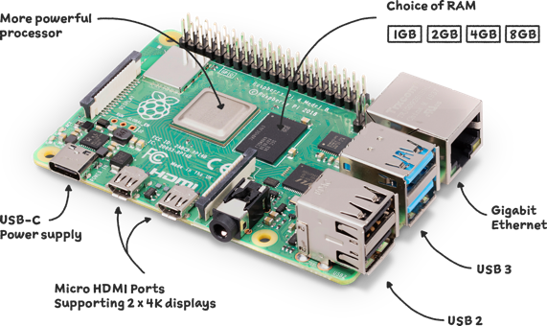
Raspberry Pi 4b
Raspberry Pi’s are micro computers
Aluminum case also ensures the protection of the device
Notes:
Ip address 172.20.9.42
172.20.10.2

Slide 6
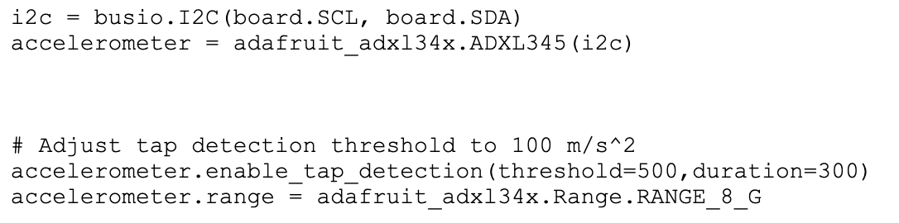
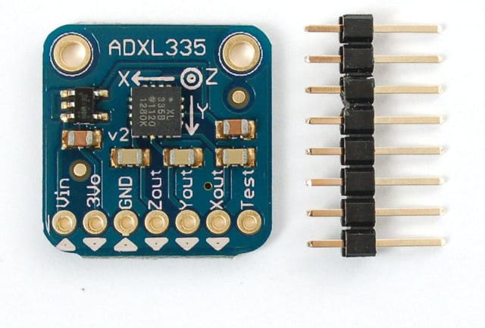
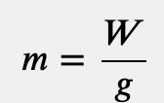
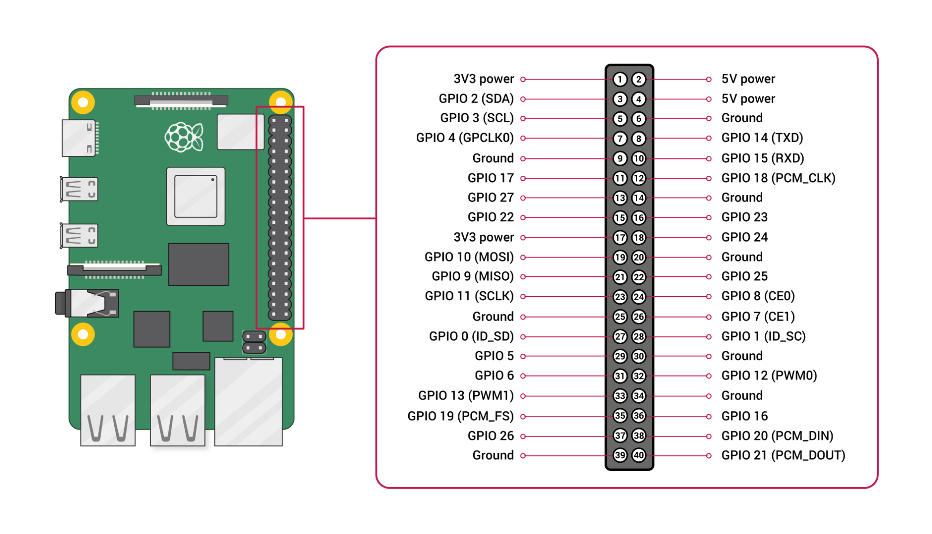

Adafruit Accelerometer
An accelerometer is a device that measures the vibration, or acceleration of motion, of a structure. The force caused by vibration or a change in motion (acceleration) causes the mass to “squeeze” the piezoelectric material which produces an electrical charge that is proportional to the force exerted upon it.
This allows us to track force exerted on a players head
Notes:
Green - 3.3V
Gray - GRND
Blue - SCL
Purple -SDA

Slide 7
Adafruit Library
The tap detection parameters.
:param int tap_count: 1 to detect only single taps, and 2 to detect only double taps.
:param int threshold: A threshold for the tap detection. The scale factor is 62.5 mg/LSB\
The higher the value the less sensitive the detection.
:param int duration: This caps the duration of the impulse above ``threshold``.\
Anything above ``duration`` won't register as a tap. The scale factor is 625 µs/LSB
:param int latency: (double tap only) The length of time after the initial impulse\
falls below ``threshold`` to start the window looking for a second impulse.\
The scale factor is 1.25 ms/LSB.
:param int window: (double tap only) The length of the window in which to look for a\
second tap. The scale factor is 1.25 ms/LSB

Slide 8
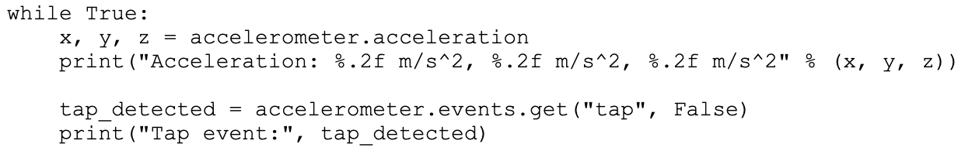
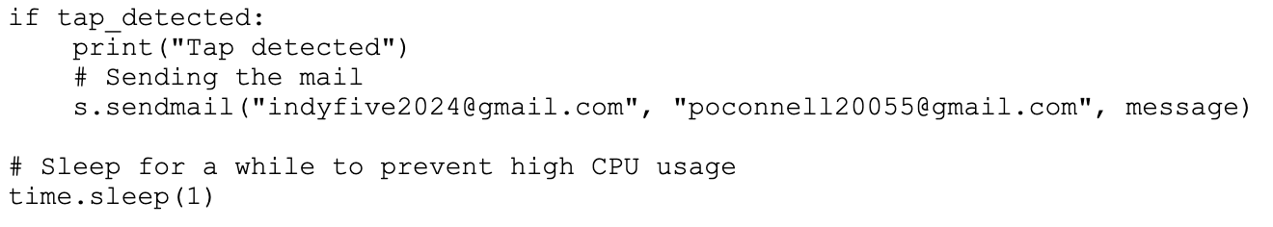
What happens during hit
if tap_detected:
print("Tap detected")
# Sending the mail
s.sendmail("indyfive2024@gmail.com", "poconnell20055@gmail.com", message)

Slide 9

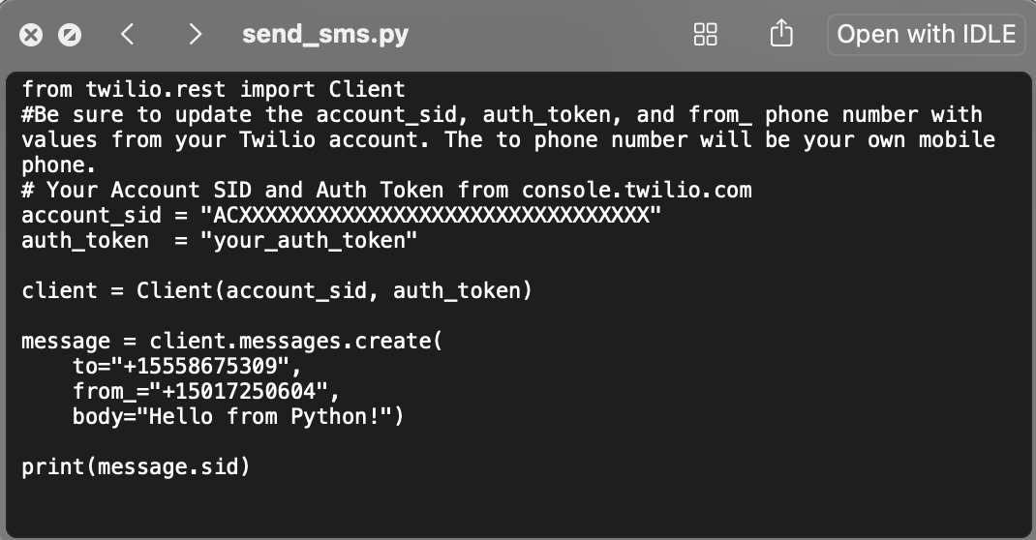
Twilio
Provides a messaging software tool
Able to connect to API in order to send a message to alert the coach of a hit
By using Twilio makes it simple for the user, no need for an app or other interface to connect to device

Slide 10
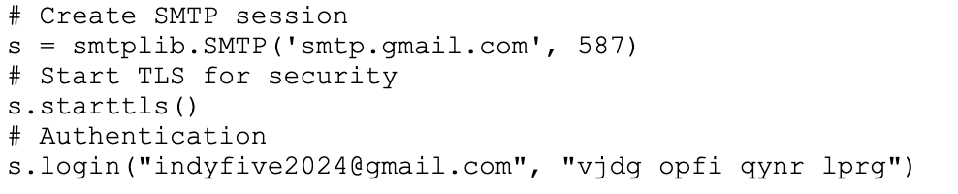
SMTP
Simple Mail Transfer Protocol
Sets up connection to a google email account
Allows for email to be sent containing a message

Slide 11
Ideas for the future:
Some sort of database that tracks the force and calculates somehow to accumulate the force that could add up to a concussion (not realistic need billions of dollars and larger team)
Implement some sort of feedback system that allows real users to send feedback to us about how to make it better (from coaches/players)
Somehow make it smaller so we don’t need to remove padding
Implement texting feature for a quicker response for coaches

Slide 12
Demonstration

